Slide 1
Possible Themes:
1) Enslavement/ Sale in Africa
2) Middle Passage
3) Sale and Labor in the Americas
4) Enslaved People

Slide 2
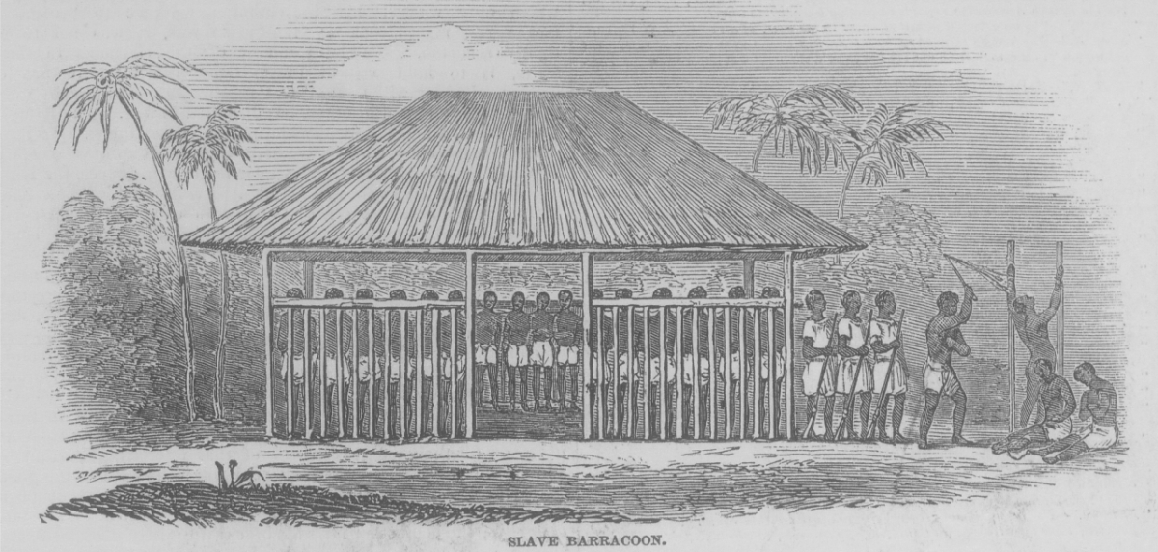
Slave Barracoon, (The Illustrated London News (Apr. 14, 1849), vol. 14, p. 237). RIGHTS THROUGH VOYAGES.

Slide 3
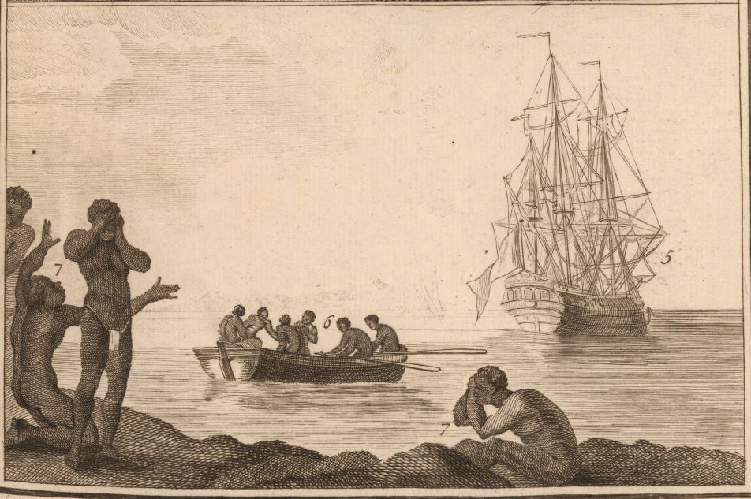
“Marche d’esclaves,” c.1784. RIGHTS THROUGH BROWN

Slide 4
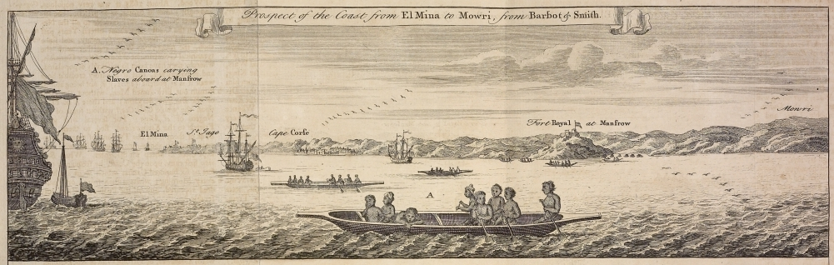
“Prospect of the Coast from El Mina to Mowri, from Barbot & Smith,” In Thomas Astley (ed.), A New General Collection of Voyages and Travels (London, 1745-47), vol. 2, plate 61, facing p. 589. RIGHTS THROUGH VOYAGES

Slide 5
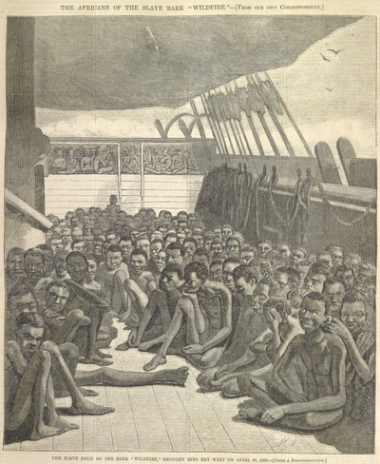
Wildfire, c.1860. RIGHTS THROUGH BROWN.

Slide 6
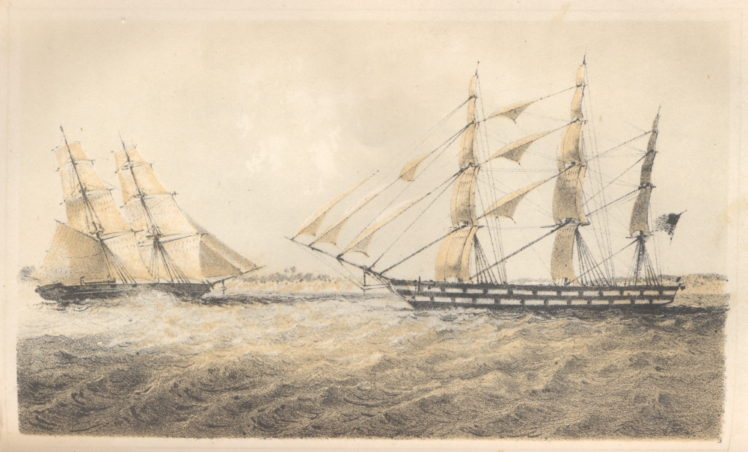
U.S. Naval Brig ""Perry"" Approaching Slaver ""Martha"“ c.1850 (Andrew H. Foote, Africa and the American Flag (New York, 1854), p. 286). RIGHTS THROUGH VOYAGES.

Slide 7
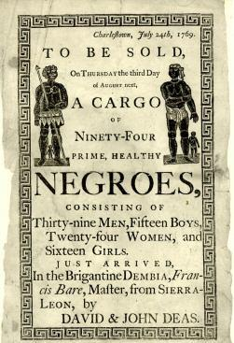
“To Be Sold…” 1769. RIGHTS THROUGH BROWN

Slide 8
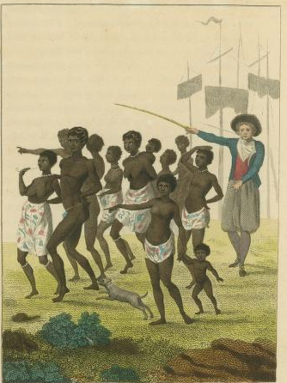
Group of Negros, as imported to be sold for Slaves, c.1793. RIGHTS THROUGH BROWN

Slide 9
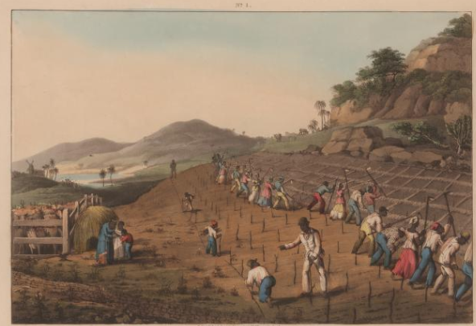
Holeing a Cane Piece, c.1833

Slide 10
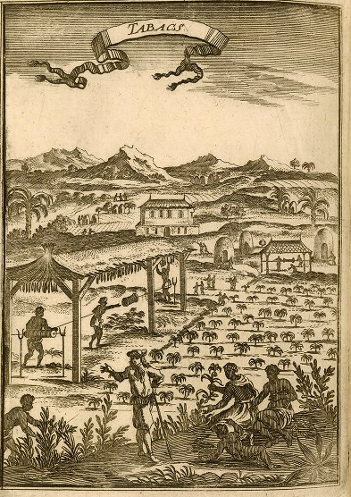
Tabacs, c.1686

Slide 11
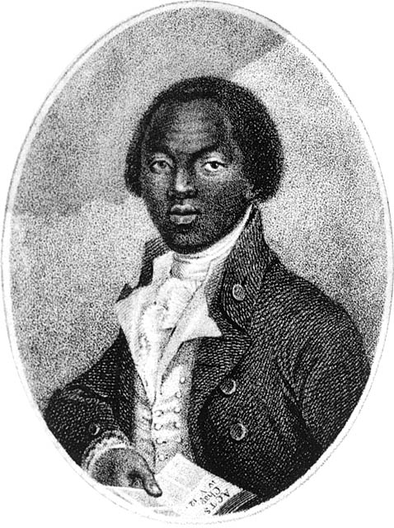
Olaudah Equiano, c.1787. RIGHTS THROUGH BROWN

Slide 12
Images that we don’t possess the rights to

Slide 13
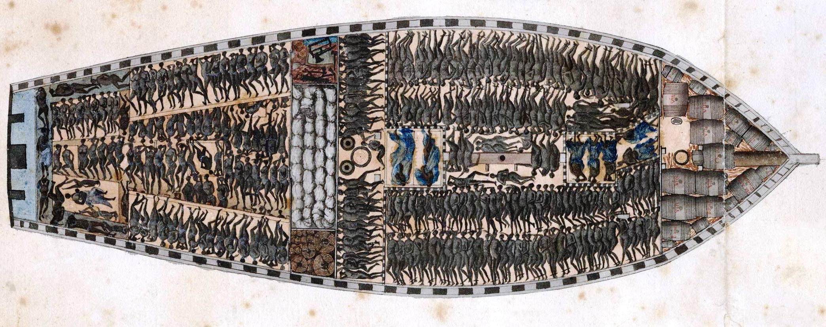
Marie Seraphique, c.1771 (Rights: Musee d’Histoire de Nantes)

Slide 14
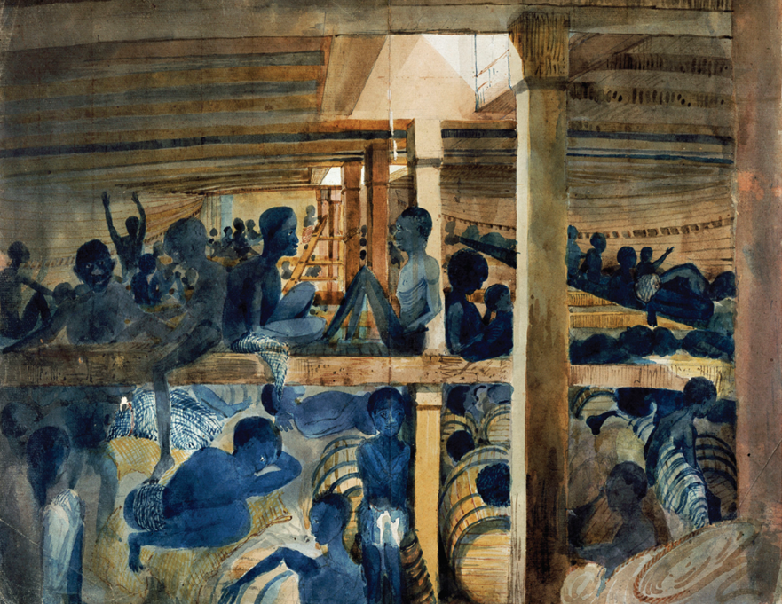
Albanez, 1845 (Rights: National Archives, London?)

Slide 15
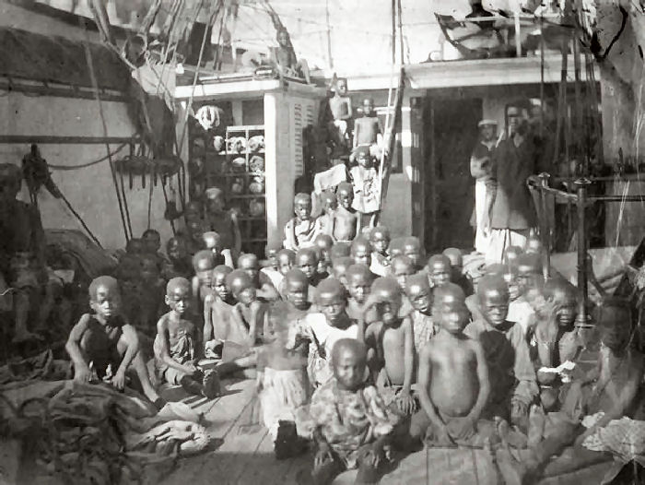
HMS Daphne, c.1868 (Rights: National Archives, London)

Slide 16
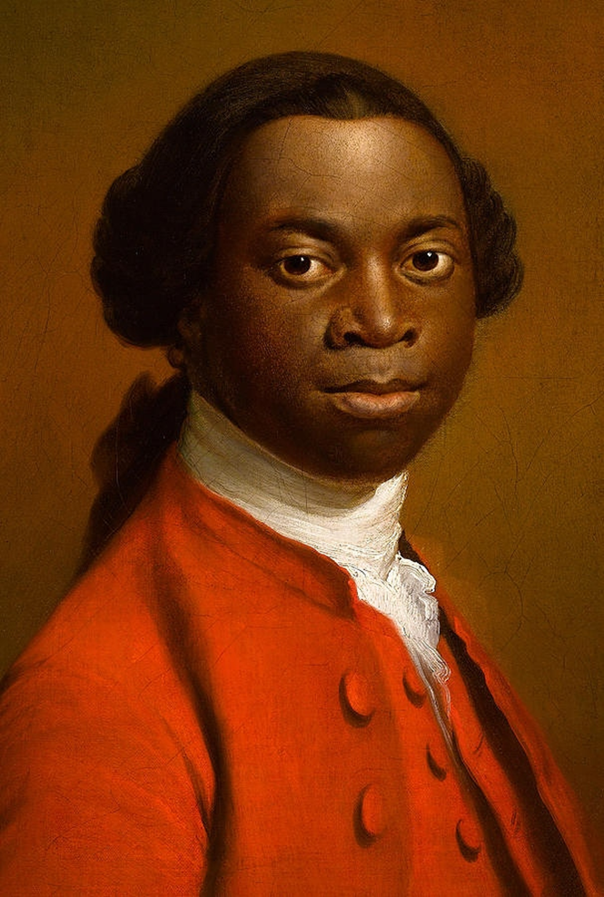
Unknown African in England. Ottobah Cugoana? Ignatuis Sancho? (Rights: Royal Albert Memorial Museum and Art Gallery)

Slide 17
Potential Options

Slide 18
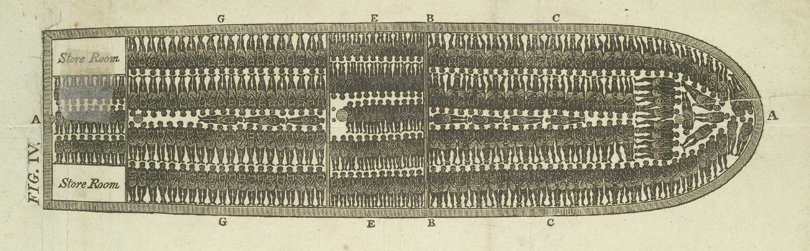
Description of a Slave Ship, 1788. PUBLIC DOMAIN?

Slide 19
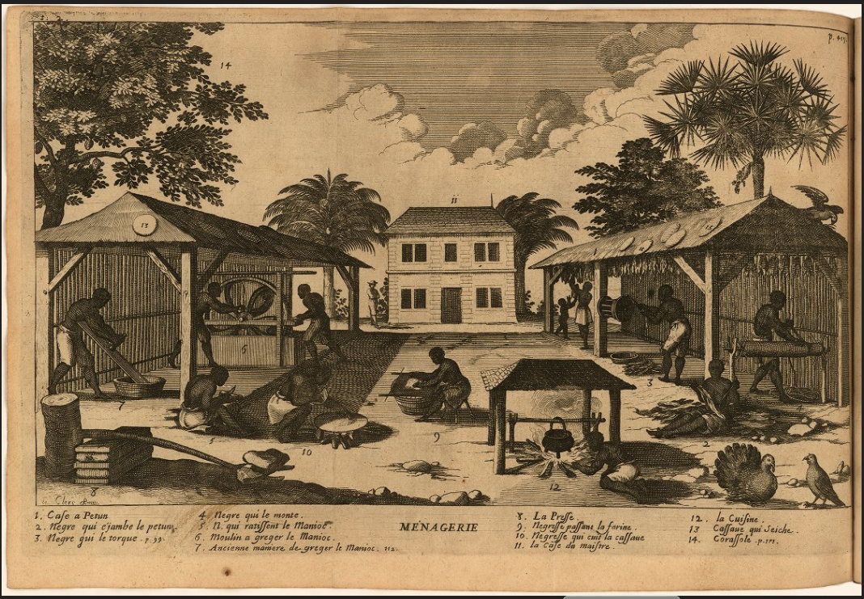
Menagerie, c.1667. RIGHTS THROUGH BROWN

Slide 20
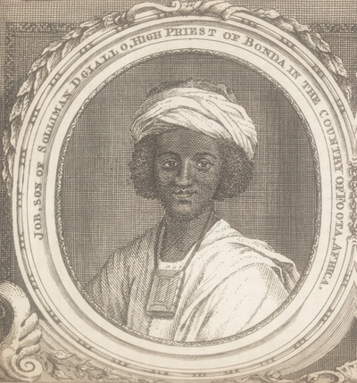
Job Ben Soloman, c.1750 ( Gentleman's Magazine (Jun., 1750), vol. 20, facing p. 272). RIGHTS THROUGH VOYAGES

Slide 21
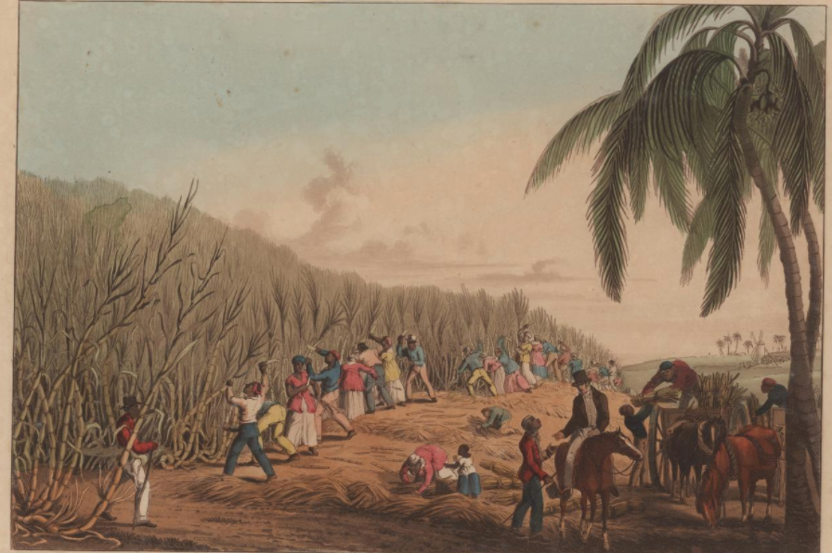
Cutting the Sugar Cane, c.1833. RIGHTS THROUGH BROWN

